Slide 1

Enhancing Business Value through Sustainability
ERM Executive Business Forum 2017
The business of sustainability

Slide 2
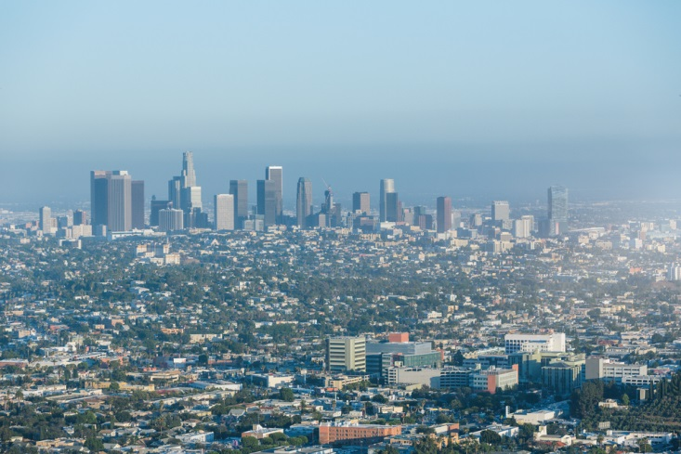
CDL
DBS Bank
I Squared Capital
Jardine Cycle & Carriage
Keppel
OCBC
SCG
Sembcorp
Sime Darby
Suntory Beverage & Food
Swire Pacific Offshore
Syngenta
TNB
Thai Union
Unilever
Asian companies have aspirational sustainability and value-creation goals, but often struggle to articulate the business case for change.
The business of sustainability

Slide 3
“We have engaged investors to show them Sustainability business case, e.g. sustainable land development.”
“Most large corporations still struggle between wanting to do the right thing, and financial returns.”
“Some investors look for longer term vision in Sustainability, but this is not consistent across the board e.g. investors from different regions have differing expectations.”

Slide 4

Some of the region’s leading companies have been successful in creating new markets and competitive advantage by integrating Sustainability into new business models.
The business of sustainability

Slide 5
Leading companies are integrating Sustainability into NEW BUSINESS MODELS to unlock value
Sustainable Value Creation / Business Outcomes
Value Enhancement/ Operational Outcomes
Tomorrow
15%
Value Protection/ EHSS Activity
43%
+ve Impact on Business Value
Today
Focus on Compliance
35%
31%
7%
46%
23%
23%
Degree of Integration

Slide 6
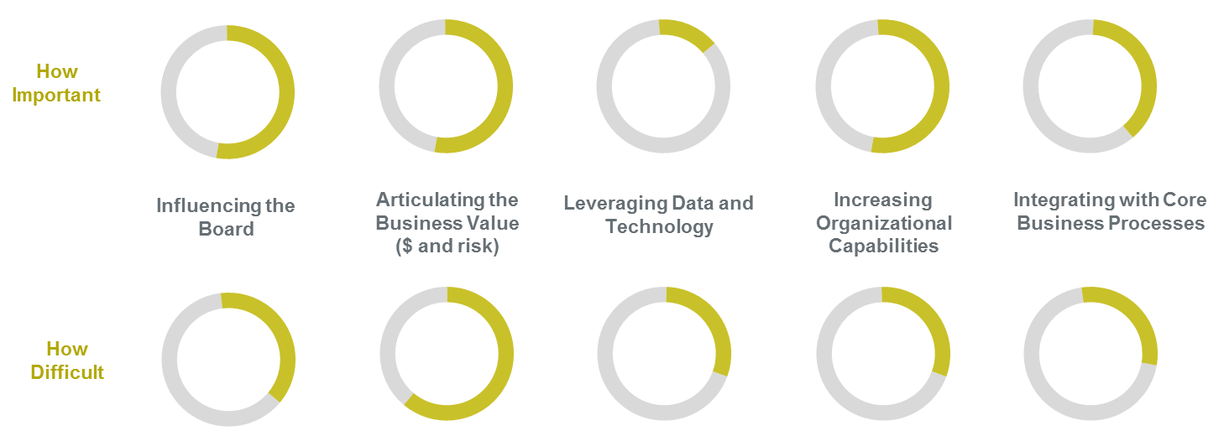
How important and difficult are these factors?

Slide 7
“We want to do the right thing for the long term, but the difficulty is in ‘How do we get this working?’ In the organization there are silos that are not working together.”
“We try to get the right group of longer-term shareholders to derive higher value for Sustainability.”
“The power of inspired leadership is a driving factor. It is important to start somewhere and expand out, the more people do, the more people will gain experience and learn.”

Slide 8

Tomorrow’s EHS/Sustainability leaders need to reinvent themselves around three key attributes: Business acumen; Leadership by influence; and Collaborative approach.
The business of sustainability

Slide 9

Digital revolution has yet to take hold in Sustainability in the region, although applying data and analytics is seen as critical to driving change.
The business of sustainability

Slide 10
ERM GLOBAL PERSPECTIVES
Growing trend towards value creation – with companies increasingly framing Sustainability as a way to find and exploit new sources of value, not just manage risk around existing ones.
The need to actively drive operational integration – by working to engage well beyond the functional EHSS silo to help the core business unlock value.
Applying data and analytics as a significant source of potential value.
Entering strategic partnerships with other organizations to achieve objectives.
The business of sustainability

Slide 11
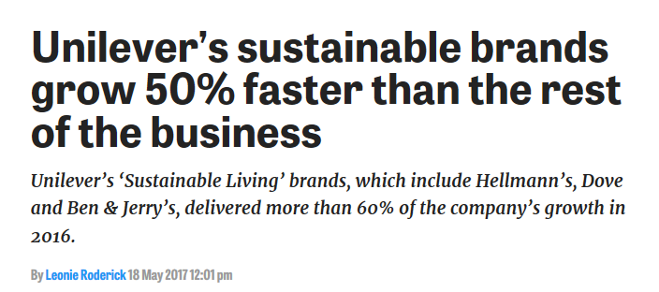
Research commissioned by Unilever showed that over half of all consumers already buy or want to buy Sustainably.
33% already purchase products with sustainability in mind, and a further 21% do not currently but would like to.
Notes:
Most leading companies have already shaped their strategy using SDG.
SDG as common platform of discussion and reporting with peers.
SDG is used as a tool to engage stakeholders.
The ‘push’ will come from global companies and financial community.

Slide 12
ERM works increasingly involve implementing the Sustainable Development Goals (SDGs), either as stand-alone programs or integrated into the core business of the company.

